Slide 1
Administration Portal Design - Part 1
Derek Brandt
Tyler Orman
Aryan Rao
Israel Sanchez Tellez
Faculty Advisor: Dr. Ashfaq Khokhar

Slide 2
Agenda
Project Overview
Ideation
Market Research

Slide 3
Project Overview

Slide 4
Project Overview
DigiClips is striving to be a website that catalogs diverse media content
including news coverage, advertisements, radio broadcasts, and podcasts.
Our team’s primary objective centers on revitalizing
the administration portal which oversees
users and server status.

Slide 5
Ideation

Slide 6
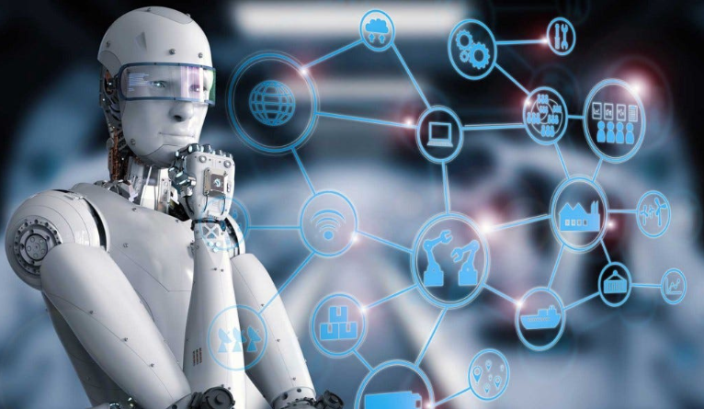
Ideation
In the Lotus Blossom, we started out with advanced tools that would be amazing to have.
AI Search Algorithms
Quantum Computer as Server
Multiple Encryption Functions

Slide 7
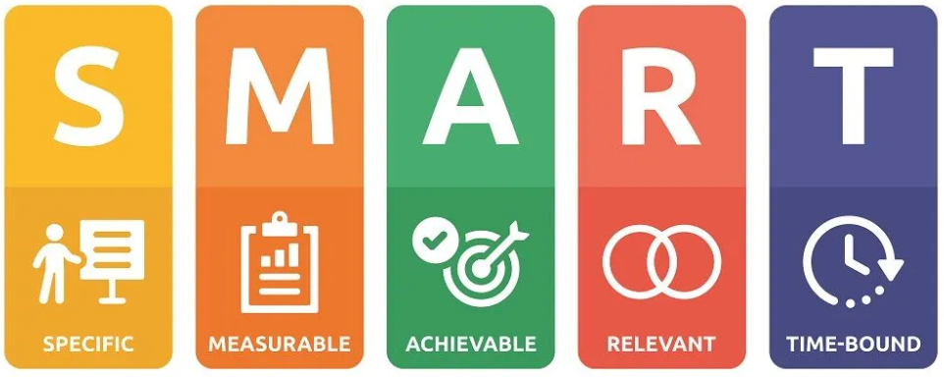
Ideation
Identified SMART Goals for the Administration Project
Accessibility Options
Angular Material Library
Automated Testing
Github Actions
TDD
Use TDD wherever possible

Slide 8
Market Research

Slide 9
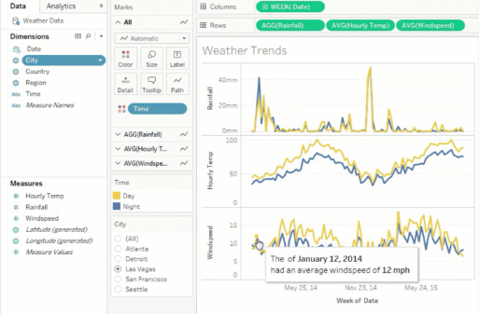
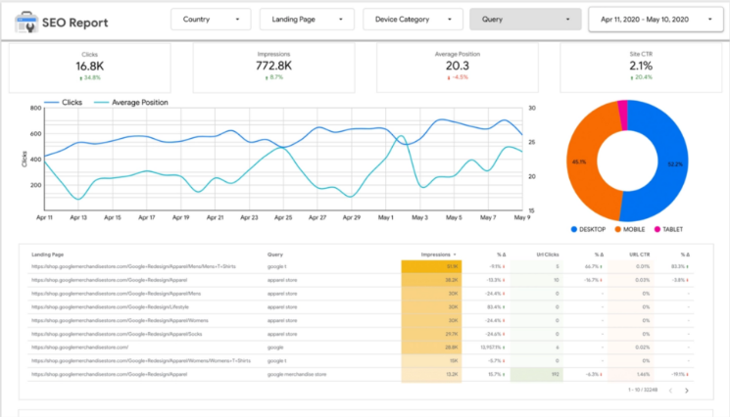
Market Research
Tableau
Tableau and Looker are data visualization softwares.
Offer high customizability to meet user’s needs.
Premium pricing too expensive for DigiClips Administration Portal
Looker

Slide 10
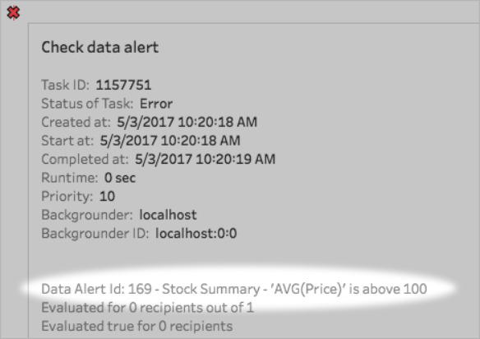
Market Research
One thing we may be able to reproduce from these companies is notifications to admins.
Send notifications when a server is down or multiple errors are received.

Slide 11
Questions?

